Slide 1
Forex intervention and reserve management in Switzerland and Israel
A discussion on Alex Cukierman’s paper
TAU macro workshop, July 10 2017
Amit Friedman, Market Operations Department, Bank of Israel

Slide 2
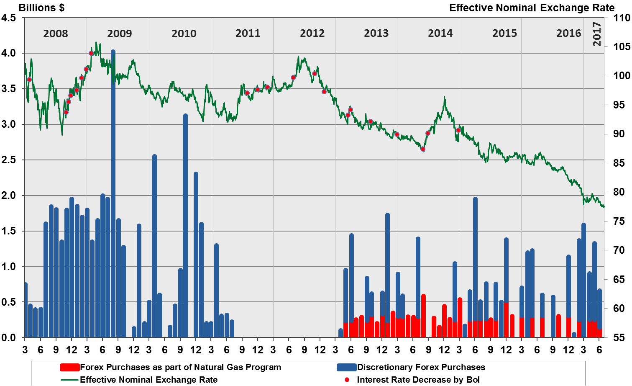
FX purchases and the Effective ER
appreciation

Slide 3
The case for FX intervention
Global monetary conditions lead to ER overvaluation
Heavy ER is a drag on exports and on inflation
The key rate is ~ ZLB, be it 0.1 or -0.75
FX intervention is an additional monetary instrument
Additional monetary leeway
The Questions
Is this policy effective?
Does it affect the level of the ER?
What are the costs?

Slide 4
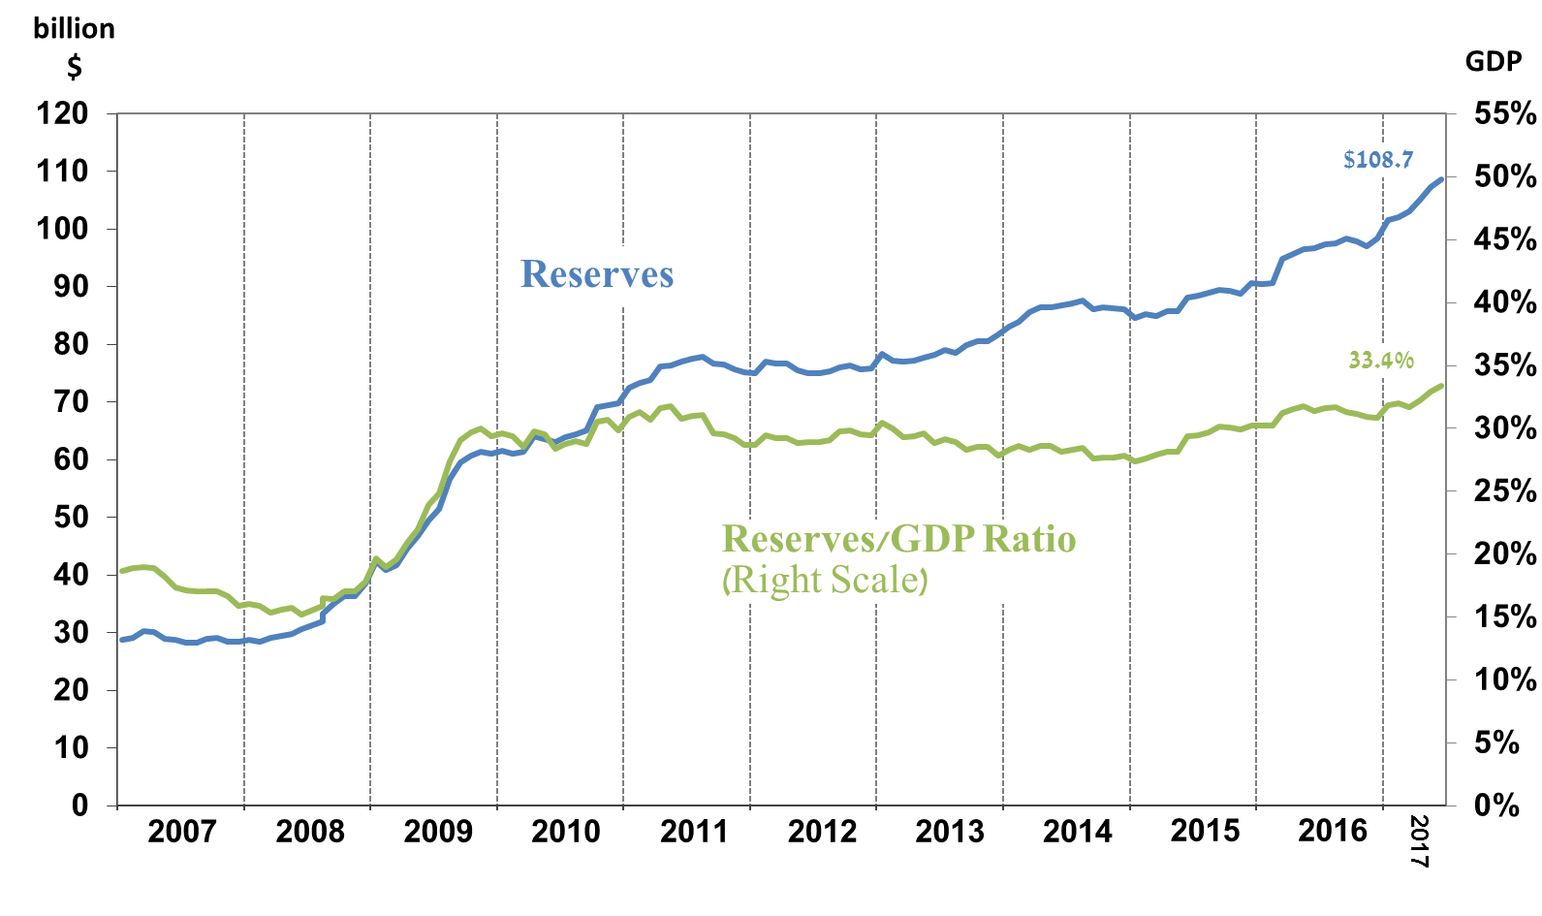
FX reserves in Israel

Slide 5
Main takeaways
Part I: FX Intervention
“Modest results on the effectiveness”
1. FX intervention works – it reduces ER volatility
2. This policy leads to a massive reserves build-up
Part II: Investment
3. The cost of holding reserves can be reduced by increasing the risk/return profile
4. A possible option is to “transfer” reserves to an SWF

Slide 6
Does lower volatility indicate effectiveness? Two “typical” intervention “snapshots”, intraday data
USDILS
USDILS
hour
hour
Sometimes yes…
And sometimes no…

Slide 7
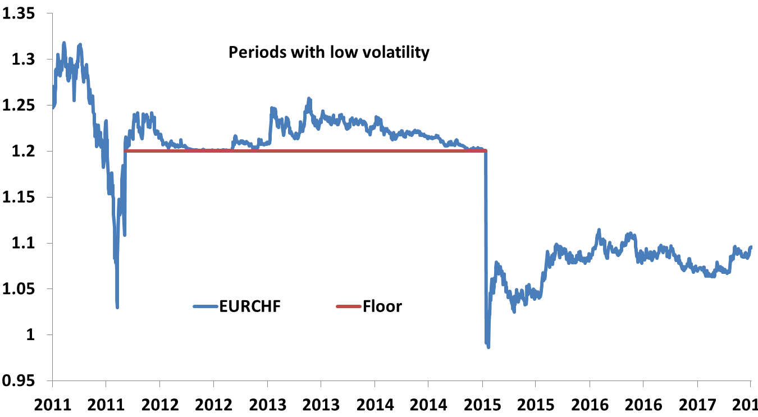
The answer also depends on the ER regime If the ER is traded at the floor there is no “premium” for the regime, maybe because it is not fully credible

Slide 8
Part I: Summary
Lower volatility provides some indirect evidence for effectiveness under a “float” regime (Israel)
But not under a floor when volatility is low and the ER is at the floor (Switzerland)
The question: do FX purchases substantially affect the level of the ER? – remains unanswered

Slide 9
Part II
The returns and volatility: SWF > SNB > BOI
This is very reasonable, given the portfolios’ compositions
BOI: 13% equities, passive (DM)
SNB: 20% equities, passive (DM+EM)
SWF: 70% equities, active - Beta>1 (DM+EM)
Alex’s recipe: transfer (some of) reserves to an SWF
1. It is difficult to compare us as asset managers
2. We have liabilities too, an SWF would have to “pay”

Slide 10
Is it possible to run a horse-race between asset managers with very different goals?
 | Bank of Israel | SNB (my interpretation) | Norwegian SWF (my interpretation)
“Philosophy” | Safety 2. Liquidity 3. Return | Safety Return Liquidity | Return Return Return
Investment Horizon | Short FI duration ~1.5Yr | Medium FI duration ~ 4Yr | Long
Benchmark/ riskless asset | Numeraire (67% $, 30% EUR, 3% GBP) | Local currency | Synthetic currency (?)
Objective function / Risk tolerance | Max vs BM s.t./ 95% CVAR <400bp (numeraire terms) | Max vs. BM s.t. / 95%CVAR~1200bp (local currency) | Absolute return 4% annual drawdown

Slide 11
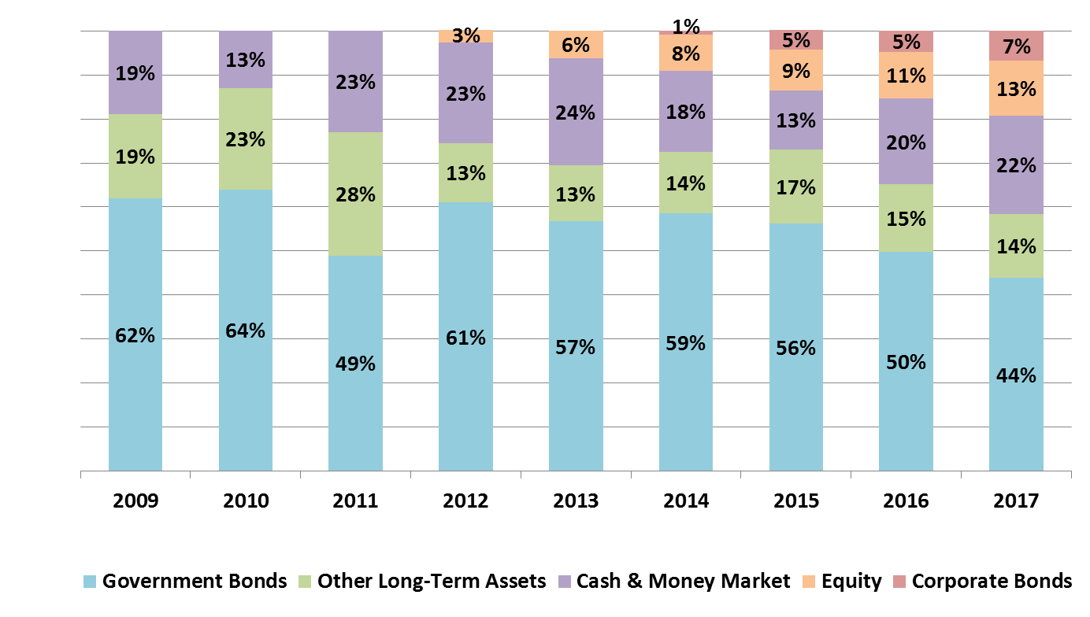
FX reserves in Israel We have a single tranche in which the allocation changes over time.

Slide 12
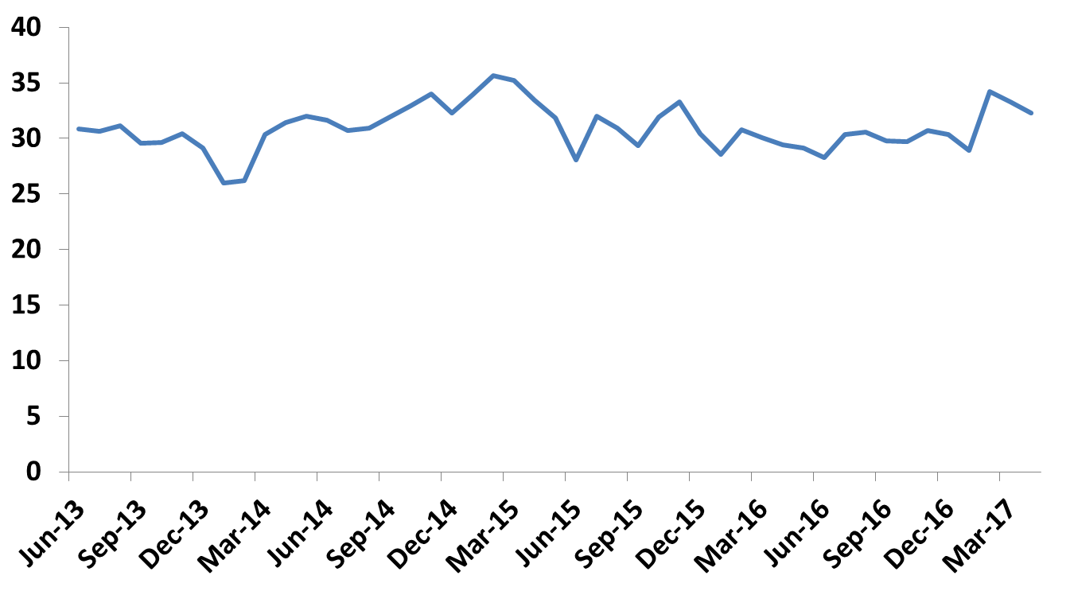
The “marginal” allocation to equities Share of equities in FX reserves above $64 billion
%

Slide 13
What is the cost of holding reserves ?
The balance-sheet cost to the CB does not represent the real cost to the economy
The national cost of holding reserves is not that high
And holding reserves has some benefits too
Holding above the optimal level may have real costs, depending on the RP (negative in SW, very low in IL)

Slide 14
Summary
Very difficult to compare the performance of the BOI, SNB and Norway’s SWF.
The BOI’s asset allocation has substantially changed in recent years, so multi-year averages are problematic
An SWF in Israel is in the pipeline (2020). It should attenuate the symptoms of the “Dutch disease”.
In Israel: a “transfer” to an SWF might be self-defeating if the ER is overvalued. Under “normal” conditions it might be optimal.
In Switzerland: such a “transfer” would have an undesirable impact on the monetary base.

Slide 15
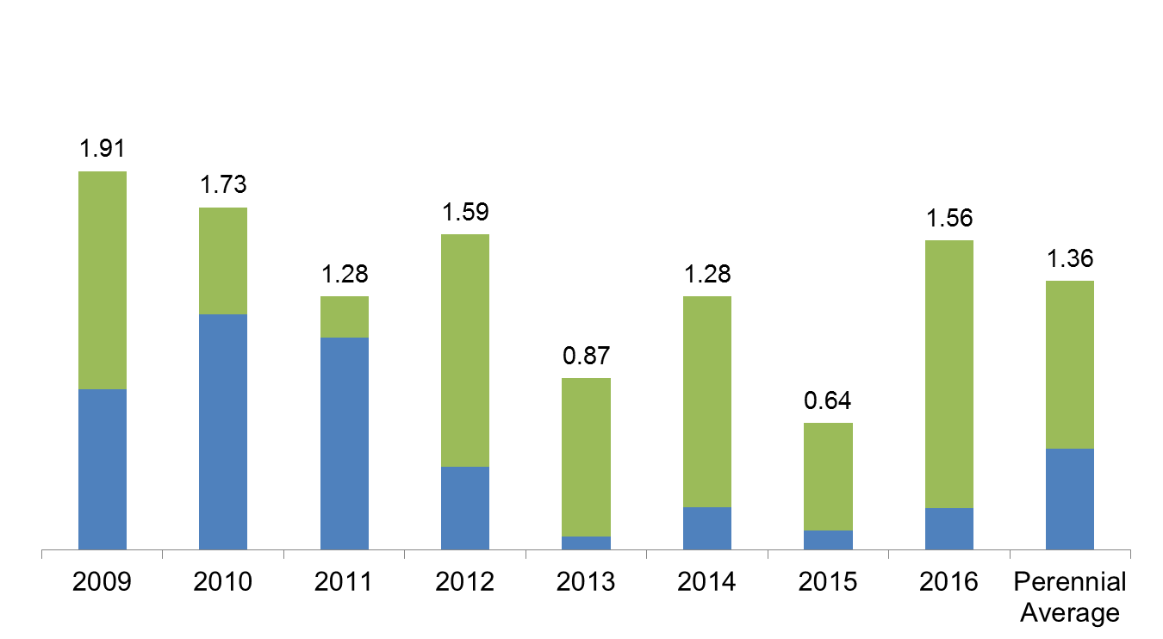
BOI reserves: annual returns (%) The contribution of the numeraire benchmark and active management
Numeraire benchmark Active management

