Slide 1
Human capital, on-the-job search and the life-cycle
Tanya Baron
Macro Workshop
08 June 2015

Slide 2
Introduction
Life-cycle log wage profile is increasing and concave
Rubinstein, Weiss (2007) - review post-schooling wage growth in the US, stipulate that two major forces behind it are on-the-job search and human capital accumulation.

Slide 3
Introduction
A fundamental question: what is the relative input of on-the-job search and experience accumulation in wage growth?

Slide 4
Literature Review
Structural models Bagger et al. (2014), Menzio et al. (2012), Yamaguchi (2010), Bowlus and Liu (2012)
Common result: there is no "action" in on-the-job search component after first 5-10 years in the labor market. Mixed evidence on relative impact (not always comparable).
Exogenous offers distribution
The same offers distribution for all workers
Econometric reduced-form studies Barlevy (2008), Schonberg (2007), Adda et al. (2013), Altonji et al. (2013)
Impact of unemployment on subsequent wages Addison and Portugal (1989), Jacobson et al. (1993), Gregory and Jukes (2001), Davis and von Wachter (2011)

Slide 5
Research question
What is the relative input of OTJ, HC when offers distribution is endogenous and changes over career? What is the role of unemployment history?
3 sources of wage dynamics: on-the-job search, actual experience(+), unemployment history (-).
Distribution of offers is endogenous, and changes over career, reflecting changes in labor market parameters and shortening of horizon

Slide 6
Results
Novel predictions about the role of OTJ search.
higher impact at the beginning (vs comparable studies)
non-trivial dynamics in the second half of a career
Small impact of unemployment history on average conceals much heterogeneity, for college graduates
Calibration exercise reveals human capital processes are more intensive for college graduates than for high-school graduates.

Slide 7
Stochastic Life-Cycle
4 stages of career: 1⇒2⇒3⇒4⇒exit
Transition from S to S+1 - Poisson event at rate $φ=1/40$ (period=quarter,
10 years on average in stage)
Transition from year to year in the labor market is deterministic, transition from stage to stage is stochastic ⇒ The composition of workforce changes with potential experience.
Stage is not potential experience, but they are related

Slide 8
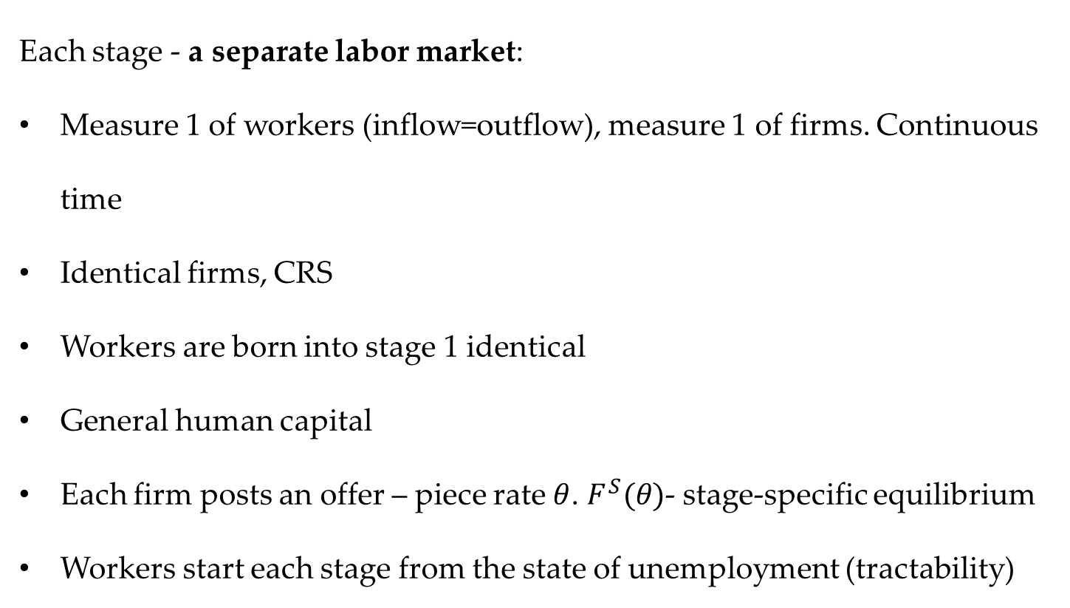
Stages
Each stage - a separate labor market:
Measure 1 of workers (inflow=outflow), measure 1 of firms. Continuous time
Identical firms, CRS
Workers are born into stage 1 identical
General human capital
Each firm posts an offer – piece rate $θ$. $F^{S}(θ)$- stage-specific equilibrium
Workers start each stage from the state of unemployment (tractability)

Slide 9
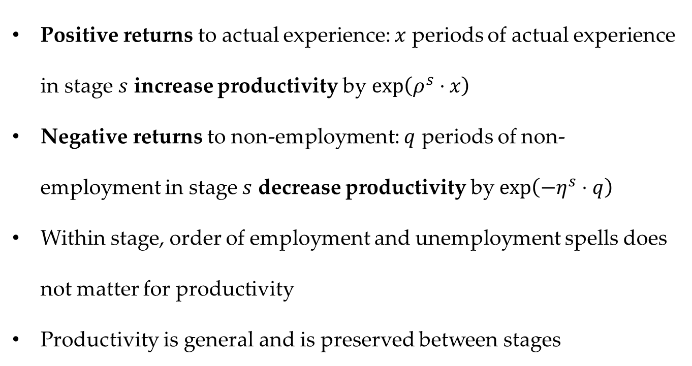
The workers. Productivity y
Positive returns to actual experience: $x$ periods of actual experience in stage $s$ increase productivity by $\exp\left(ρ^{s}⋅x\right)$
Negative returns to non-employment: $q$ periods of non-employment in stage $s$ decrease productivity by $\exp\left(−η^{s}⋅q\right)$
Within stage, order of employment and unemployment spells does not matter for productivity
Productivity is general and is preserved between stages

Slide 10
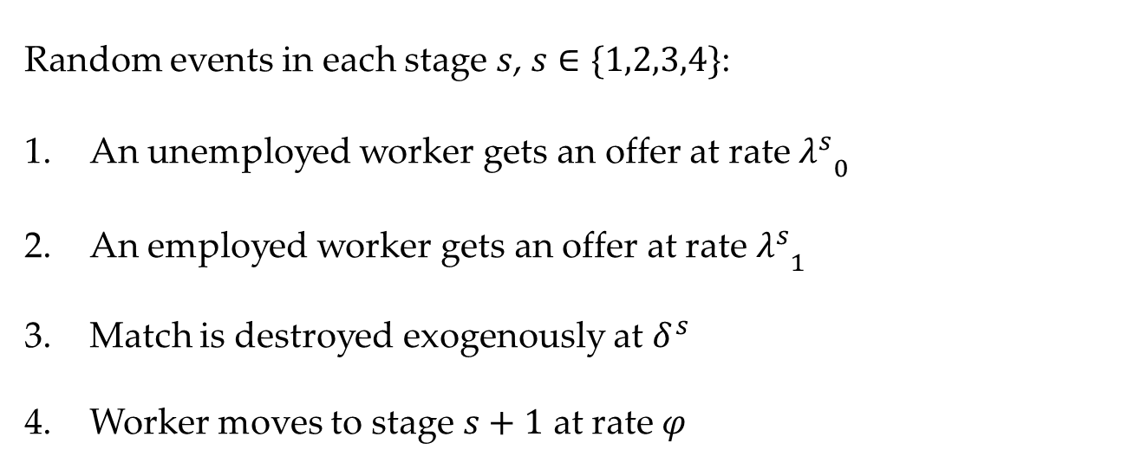
The workers. Random events
Random events in each stage $s$, $s∈\{1,2,3,4\}$:
An unemployed worker gets an offer at rate ${λ_{}^{s}}_{0}$
An employed worker gets an offer at rate ${λ_{}^{s}}_{1}$
Match is destroyed exogenously at $δ^{s}$
Worker moves to stage $s+1$ at rate $φ$

Slide 11
Unemployed workers in stage s
$$rW^{U.s}\left(y\right)=b∙y+\frac{∂W^{U,s}\left(y\right)}{∂t}+$$
$${{+λ}_{0}}^{s}∙\int_{\underline{θ}}^{\overline{θ}}{max\left[W^{E,s}\left(y,θ^{′}\right)−W^{U.s}\left(y\right),0\right]dF^{s}\left(θ^{′}\right)+}$$
$$+φ∙\left[W^{U,s+1}\left(y\right)−W^{U.s}\left(y\right)\right]$$
Important: $\frac{∂W^{U,s}(y)}{∂t}$ is negative and proportionate to $W^{U,s}(y)$

Slide 12
Employed workers in stage s
$$rW^{E.s}\left(y,θ\right)=θ∙y+\frac{∂W^{E,s}\left(y,θ\right)}{∂t}+$$
$${{+λ}_{1}}^{s}∙\int_{θ}^{\overline{θ}}{\left[W^{E,s}\left(y,θ^{′}\right)−W^{E,s}\left(y,θ\right)\right]dF^{s}\left(θ^{′}\right)+}$$
$$+δ^{s}∙\left[W^{U,s}\left(y\right)−W^{E.s}\left(y,θ\right)\right]$$
$$+φ∙\left[W^{U,s+1}\left(y\right)−W^{E.s}\left(y,θ\right)\right]$$
Important: $\frac{∂W^{E,s}(y,θ)}{∂t}$ is positive and proportionate to $W^{E,s}(y,θ)$

Slide 13
Reservation piece rate in stage s
$θ^{R,s}$ such that $W^{E,s}\left(y,θ^{R,s}\right)=W^{U,s}(y)$
Relative attractiveness of employment over unemployment is what's important
$θ^{R,s}$ is the same for all unemployed workers in stage s
Depends on parameters of stage s and expected horizon.
Parameters:
${λ_{}^{s}}_{0}↑⟹$ $θ^{R,s}↑$
$$η^{s}↑⟹θ^{R,s}↓$$
$${λ_{}^{s}}_{1}↑⟹ θ^{R,s}↓$$
$$ρ^{s}↑⟹θ^{R,s}↓$$
$${δ_{}^{s}}_{}↑⟹ θ^{R,s}↑$$

Slide 14
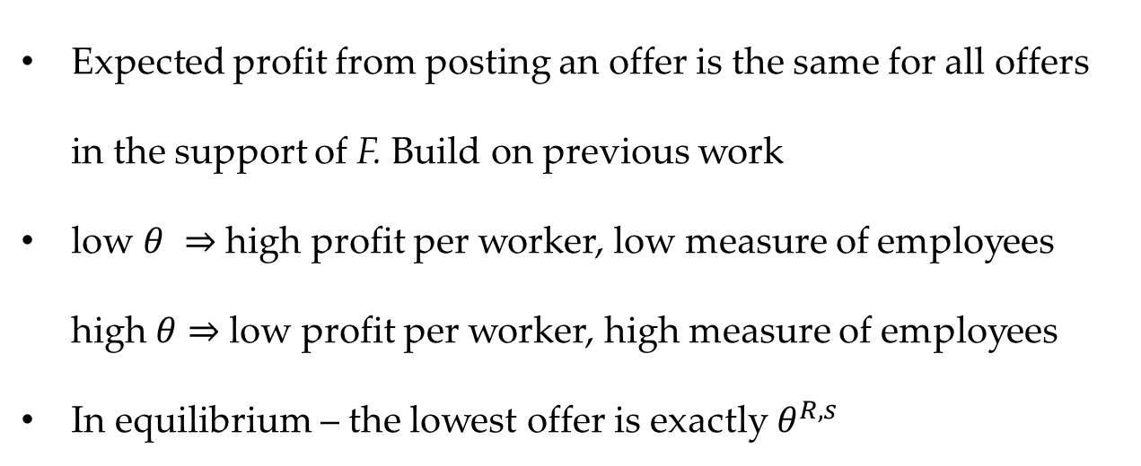
Equilibrium distribution of offers
Expected profit from posting an offer is the same for all offers in the support of F. Build on previous work
low $θ$ ⇒ high profit per worker, low measure of employees high $θ$ ⇒ low profit per worker, high measure of employees
In equilibrium – the lowest offer is exactly $θ^{R,s}$
Model solution: for each stage, from the last backwards, numerically solve for $F^{s}(θ)$, including its bounds $θ^{R,s}$ and ${\overline{θ}}^{s}$

Slide 15
Data on wage profiles in the US
CPS March Supplement, 1996-2006. white males, full-time, wage>federal min. wage, constant prices
High School Graduates (HSG) | College Graduates (CG)
86,177 observations | 59,162 observations
12 years of education | 16 years of education
Age 19+ | Age 23+
Removing cohort effects:
$$lnw_{icxt}=\sum_{C=1956}^{2005}{β_{C}∙D_{C,i}+\sum_{X=1}^{40}{β_{X}∙D_{X,i}+ε_{i,t}}}$$

Slide 16
Average Log Wage profiles for CG and HSG

Slide 17
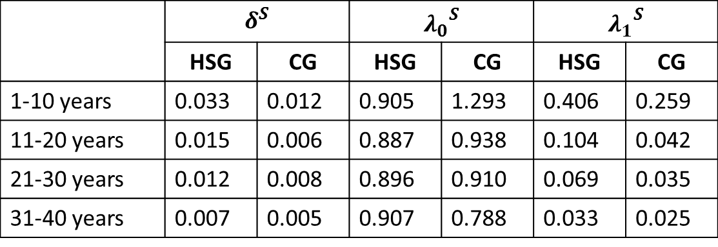
Calibration. Quarterly transition rates
Menzio, Telyukova, Visschers (2012) - SIPP 1996 panel
 | $$δ^{S}$$ |  | $${λ_{0}}^{S}$$ |  | $${λ_{1}}^{S}$$
 | HSG | CG | HSG | CG | HSG | CG
1-10 years | 0.033 | 0.012 | 0.905 | 1.293 | 0.406 | 0.259
11-20 years | 0.015 | 0.006 | 0.887 | 0.938 | 0.104 | 0.042
21-30 years | 0.012 | 0.008 | 0.896 | 0.910 | 0.069 | 0.035
31-40 years | 0.007 | 0.005 | 0.907 | 0.788 | 0.033 | 0.025
For CG mobility deteriorates more sharply than for HSG

Slide 18
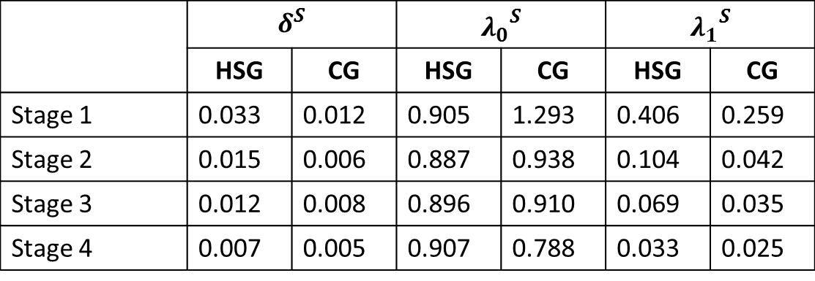
Calibration. Quarterly transition rates
Menzio, Telyukova, Visschers (2012) - SIPP 1996 panel
 | $$δ^{S}$$ |  | $${λ_{0}}^{S}$$ |  | $${λ_{1}}^{S}$$
 | HSG | CG | HSG | CG | HSG | CG
Stage 1 | 0.033 | 0.012 | 0.905 | 1.293 | 0.406 | 0.259
Stage 2 | 0.015 | 0.006 | 0.887 | 0.938 | 0.104 | 0.042
Stage 3 | 0.012 | 0.008 | 0.896 | 0.910 | 0.069 | 0.035
Stage 4 | 0.007 | 0.005 | 0.907 | 0.788 | 0.033 | 0.025
For CG mobility deteriorates more sharply than for HSG

Slide 19
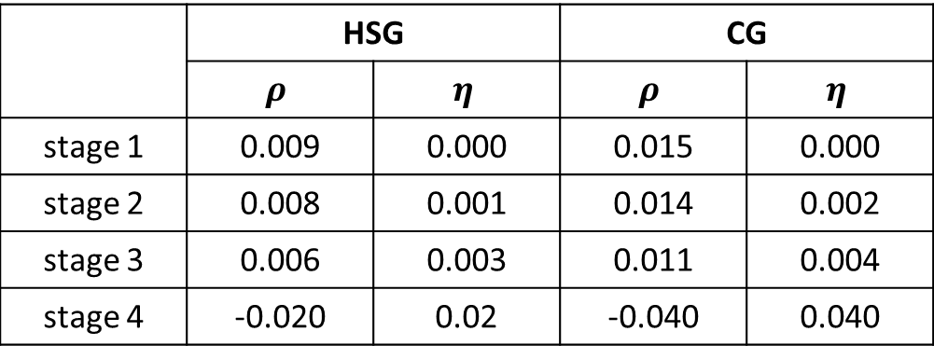
Calibration. Human capital
Simulate 10000 careers, record employment history, build wage profiles
$$\min_{ρ,η}{MSE=\frac{1}{40}\sum_{t=1}^{40}{{\left(ln{\hat{w}}_{t}−lnw_{t}\right)}^{2}}}$$
 | HSG |  | CG
 | $$ρ$$ | $$η$$ | $$ρ$$ | $$η$$
stage 1 | 0.009 | 0.000 | 0.015 | 0.000
stage 2 | 0.008 | 0.001 | 0.014 | 0.002
stage 3 | 0.006 | 0.003 | 0.011 | 0.004
stage 4 | -0.020 | 0.02 | -0.040 | 0.040
Psychology literature: fluid intelligence declines at later ages.
Productivity research: decline in productivity after 55.

Slide 20
Data vs calibrated model
MSE(HSG)=0.002; MSE(CG)=0.0024

Slide 21
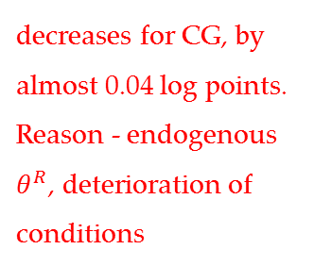
Components of wage profile
decreases for CG, by almost 0.04 log points. Reason - endogenous $θ^{R}$, deterioration of conditions

Slide 22
Inputs into total wage growth
 | over 10 years |  | over 40 years
 | HSG | CG | HSG | CG
OTJ | 44% | 29% | 26% | 13%
HC(+) | 57% | 72% | 75% | 89%
HC(-) | -1% | -1% | -1% | -2%
Altonji
Returns to HC are relatively low compared to existing literature (returns to OTJ are relatively high):

Slide 23
The role of the life-cycle assumption
$$W^{E,S}=…+\frac{∆W^{E,S}}{∆t}+…+W^{U,S+1}$$
$$W^{U,S}=…+\frac{∆W^{U,S}}{∆t}+…+W^{U,S+1}$$
positive, proportionate to${ W}^{E,S}$
negative, proportionate to${ W}^{U,S}$
$$W^{E,S}↑$$
by more than $W^{U,S+1}$
$${ W}^{U,S}↑$$
by less than $W^{U,S+1}$
$$θ^{R}$$
has to be low in the beginning!

Slide 24
The role of the life-cycle assumption
HSG
CG
Change in log piece rate over 40 years, log points
 | HSG | CG
Each stage solved independently | 0.09 | -0.03
Stages linked through life-cycle | 0.23 | 0.17

Slide 25
Impact of non-employment history for CG conceals much heterogeneity…

Slide 26
…..but not for HSG

Slide 27
Lifetime earnings
Full-time: 40 hours per week, 13 weeks per quarter, 4 quarters per year

Slide 28
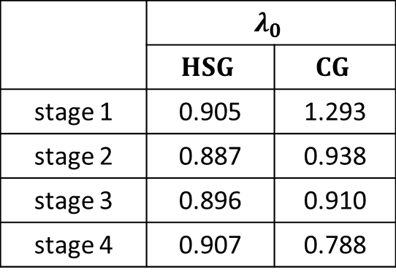
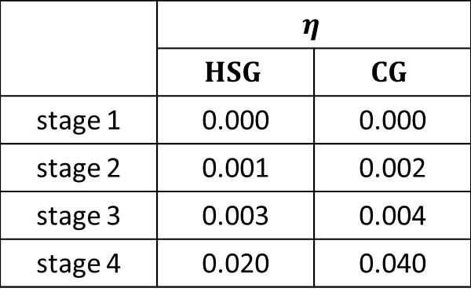
Why is CG different from HSG?
 | $$η$$
 | $$HSG$$ | $$CG$$
stage 1 | 0.000 | 0.000
stage 2 | 0.001 | 0.002
stage 3 | 0.003 | 0.004
stage 4 | 0.020 | 0.040
 | $$λ_{0}$$
 | $$HSG$$ | $$CG$$
stage 1 | 0.905 | 1.293
stage 2 | 0.887 | 0.938
stage 3 | 0.896 | 0.910
stage 4 | 0.907 | 0.788
For CG long unemployment spells tend to happen later in career more than in the beginning (see $λ_{0}$). Big losses of human capital.
For HSG – the length of unemployment spells is more uniformly distributed across stages. Human capital losses are smaller

Slide 29
Summary
3 sources of wage dynamics, endogenous distribution of offers that changes with labor market parameters and shortening of the horizon
Stochastic ageing approach to career
Predicts a higher role (than in previous studies) of OTJ search at the beginning of career, and “action” in late career.
Calibration reveals that human capital processes are more intensive for college graduates than for high-school graduates
On average, the cumulative role of human capital loss is negligible, however it conceals much heterogeneity, especially for CG

Slide 30
Future extensions
Application to a structurally different economy (Germany?)
Compare to panel data

Slide 31
Thank you!

Slide 32
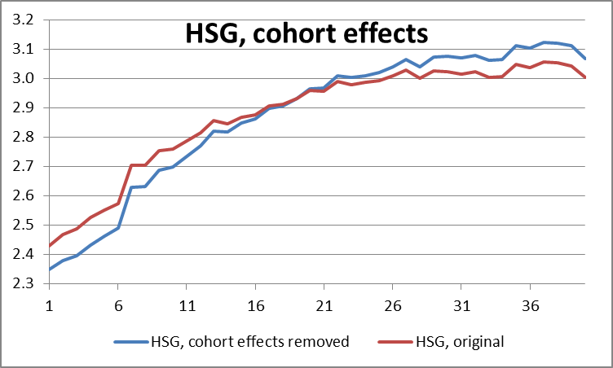
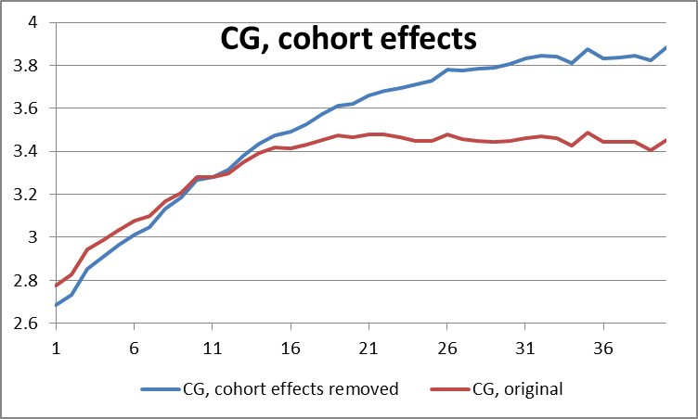

Slide 33
Profits expression
$$\frac{π\left(θ\right)}{1−θ}=$$
$$λ_{0}U∙\int_{x=0}^{∞}{\int_{q=0}^{∞}{e^{ρx}∙e^{−ηq}∙d^{2}}}S^{U}\left(x,q\right)∙\int_{τ=0}^{∞}{e^{−rτ}∙e^{−(φ+δ+λ_{1}(1−F\left(θ\right))∙τ}}∙e^{ρτ}dτ+$$
$$+λ_{1}(1−U)∙\int_{x=0}^{∞}{\int_{q=0}^{∞}{\int_{\underline{θ}}^{θ}{e^{ρx}}∙e^{−ηq}∙d^{3}}}S^{E}\left(x,q,θ\right)∙\int_{τ=0}^{∞}{e^{−rτ}∙e^{−(φ+δ+λ_{1}(1−F\left(θ\right))∙τ}}∙e^{ρτ}dτ$$

